Slide 1

BISHOPS COLLEGE 2026 • G10
EPIC
FOOD
Fuel the adventure.
FOOD • ORGANISATION • TEAMWORK
CLICK TO CONTROL THE PACE →
EPIC FOOD
01

Slide 2

STAFF HIKE 3 x 3 x 3
3 meals
3 days
3kg’s
24hr SOLO BOX 1 x 3
3 meals
More fun stuff
Can be heavy

Slide 3
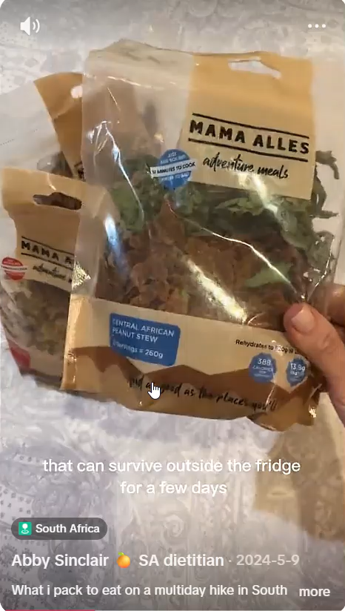

Slide 4

The HIKING food overview.
Carbs
Fats/Proteins
Some groups snack early, cook later
It’s hot and dirty.
Seldom feel like getting gas out and cooking…
Something to look forward to after a long day.
Warm meal = happiness.
Warm drink after tribal council.
BREAKFAST
LUNCH
SUPPER
2 TALK
3 MOVE
Click only when the conversation is finished.
Sugar
Carbs
Bars
Treats
Easy to access!
Water
Water
Water
Game
Protein shakes
Hot choc
Gas & burner
Utensils
Lighter
Pot
Mug
SNACKS
DRINKS
EQUIPMENT
EPIC FOOD
02

Slide 5



Slide 6


01 / MEAL PLAN
BREAKFAST
The first decision to fuel your day.
What are you going to eat?
Carbs = cereal oats hotcross buns
Protein = nuts / protein cereal peanut butter / unpeeled boiled eggs
Fats = nuts / eggs/ peanut butter
PLAN IT • PACK IT • PORTION IT
Choose something practical.
Then ask: Does it travel well? Is it organised?
Is it worth carrying?
EPIC FOOD
05

Slide 7


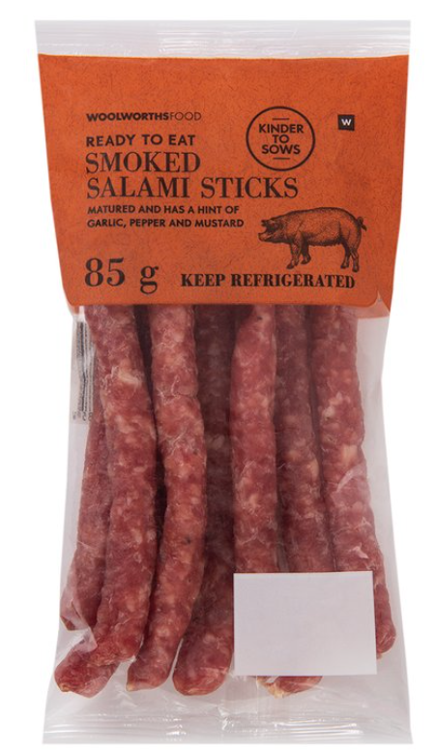
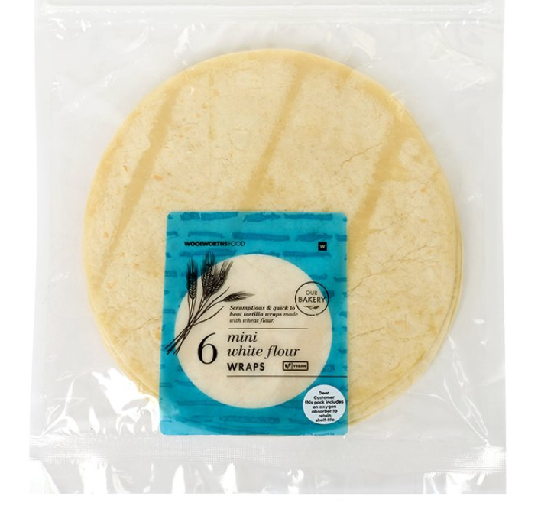
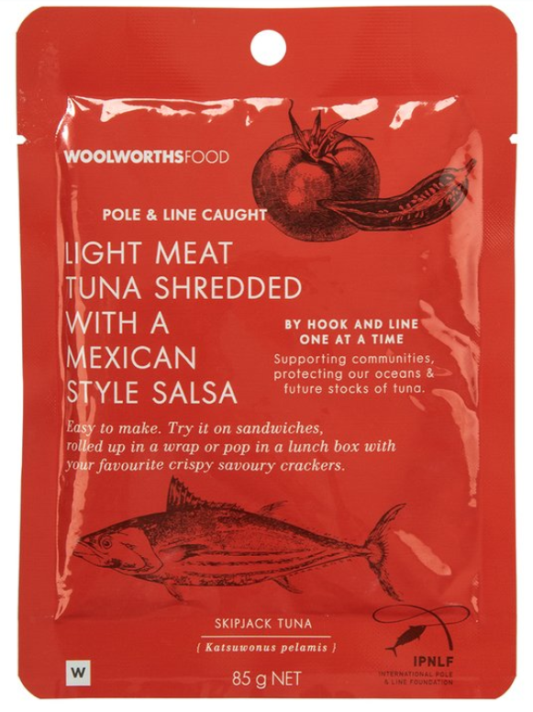
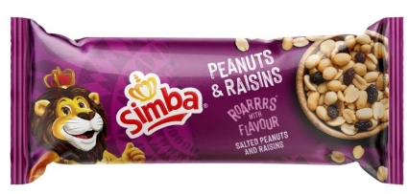
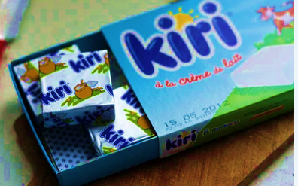

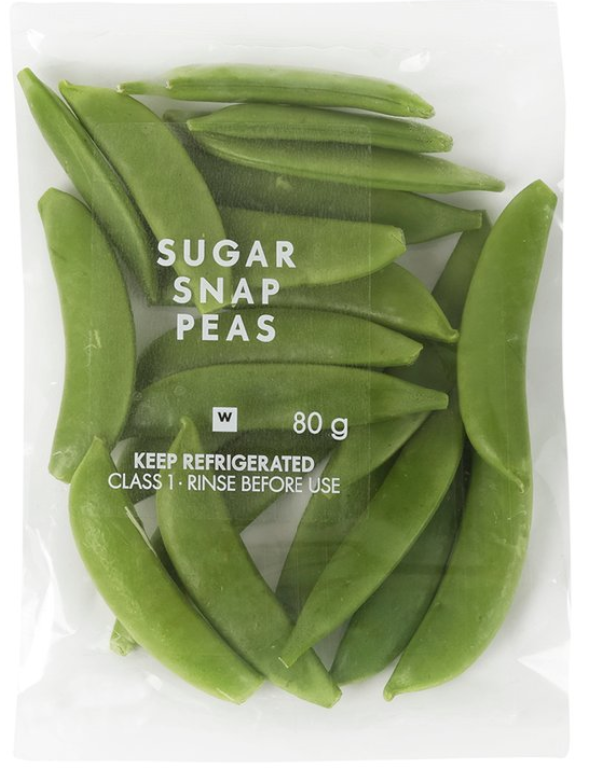
02 / MEAL PLAN
LUNCH
Keep it practical. Keep it together.
DON’T OVERCOMPLICATE IT.
EPIC FOOD
06

Slide 8
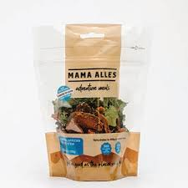
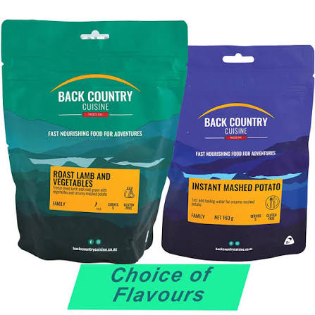
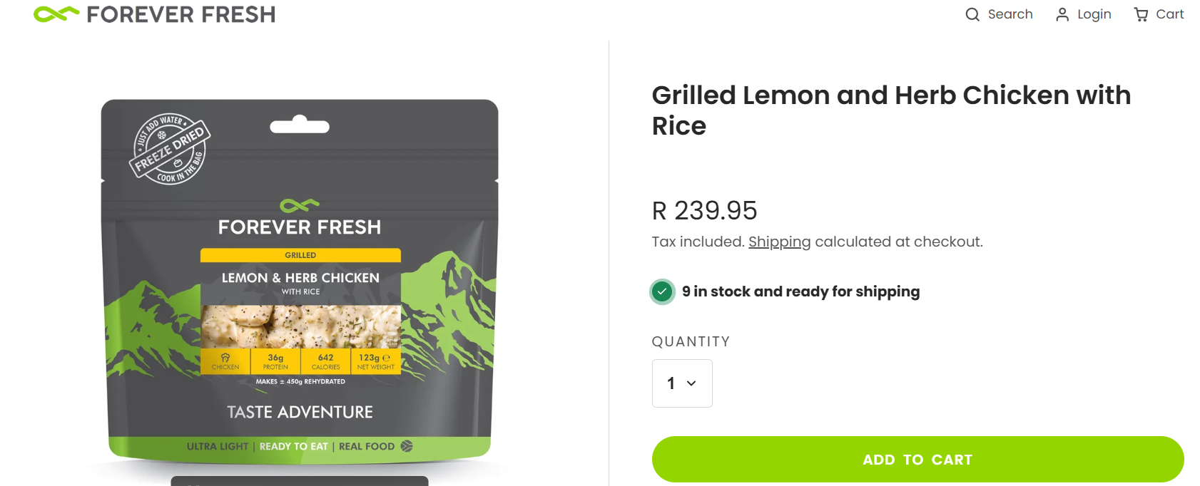
03 / MEAL PLAN
SUPPER
Dehydrated Hiking meals
*RRR*
ONE GAS PER TEAM
Preserve it.
EPIC FOOD
07

Slide 9
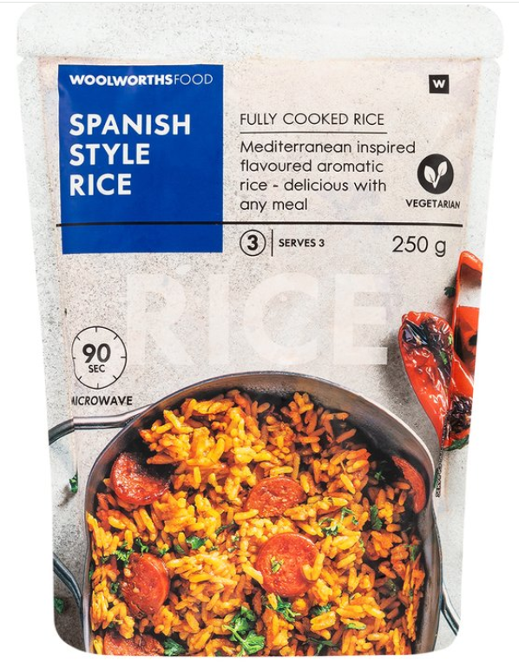
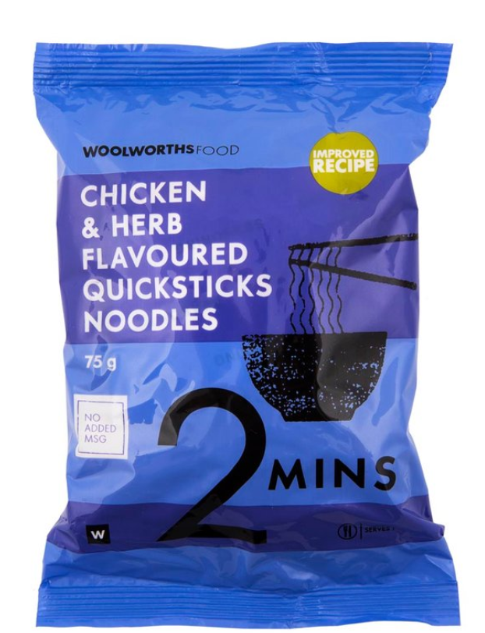
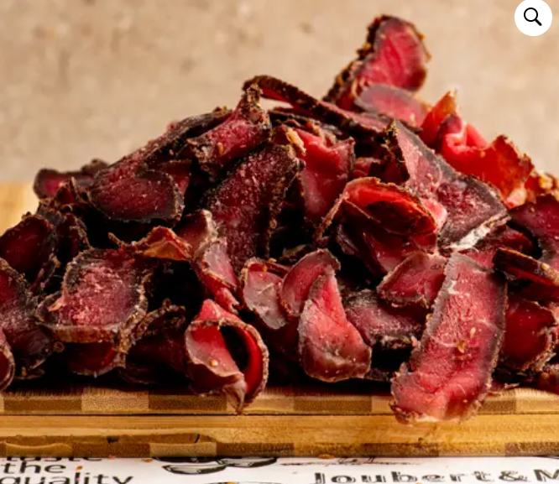

03 / MEAL PLAN
SUPPER
OTHER GOOD OPTIONS
- Suggestion to go HALF HALF
EPIC FOOD
07

Slide 10

04 / MEAL PLAN
SNACKS
Small food. Big difference.
TEAM PROMPT
EPIC FOOD
08

Slide 11
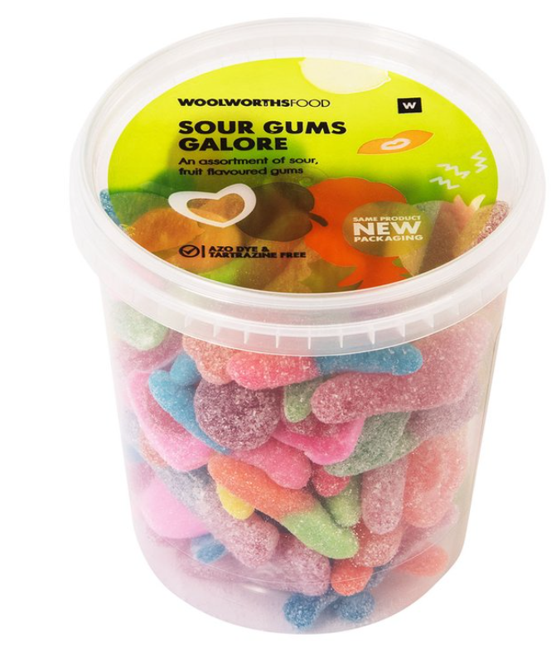

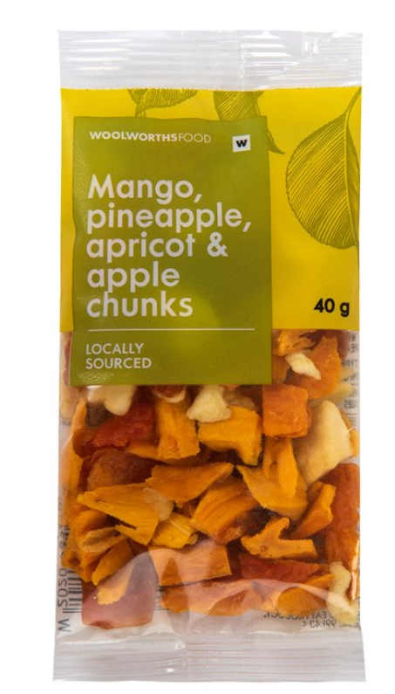

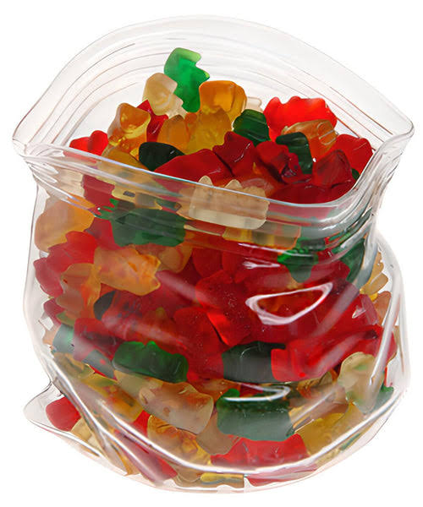



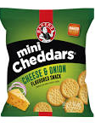


04 / MEAL PLAN
SNACKS
Small food. Big difference.
EPIC FOOD
08

Slide 12
05 / MEAL PLAN
DRINKS
Plan to carry 2 L minimum.
EPIC FOOD
09

Slide 13

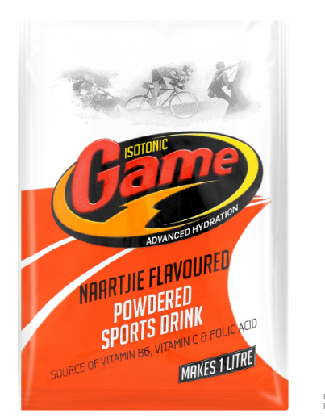


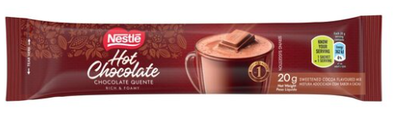
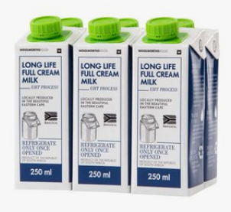
DRINKS
Plan the drink system — not just the drink.
EPIC FOOD

Slide 14



HARD STOP
BANNED
BAD IDEAS
- CREATINE
- TINNED FOOD
- INDIVIDUALLY WRAPPED SWEETS
- CHOCOLATE
EPIC FOOD
13

Slide 15
THE RULES
FOOD SYSTEM PRINCIPLES
These are the non-negotiables from the plan.
• Dehydrated — liquid-free food
• Low volume + low weight with high nutritional value
• Avoid things that melt or need refrigeration
• Keep everything organized ZIPLOCKS
THE TEST → LIGHT • COMPACT • PRACTICAL
EPIC FOOD
10

Slide 16
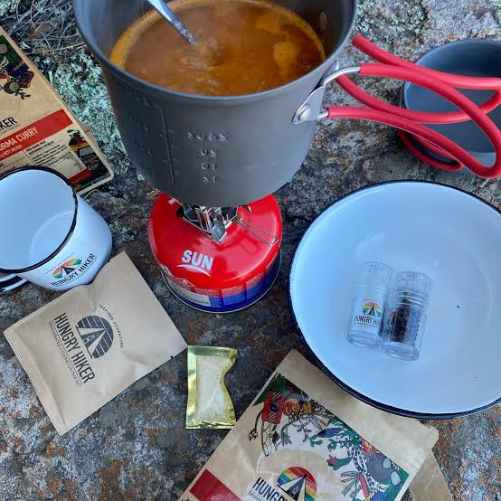
EQUIPMENT
EQUIPMENT
1 ×
GAS
PRESERVE IT!
Lighter
Pot
Pan
Mug
Waterbottles 2L
EPIC FOOD
14

Slide 17
FINAL CHECK
ARE WE READY?
Run the whole plan once before you pack.
• Breakfast planned
• Lunch planned
• Supper planned
• Snacks planned
• Drinks planned
• Food is light + compact
• No melting / refrigeration problems
• Ziplocks + wetwipes included
• Nothing individually wrapped
• Gas is protected and preserved
PACK IT YOURSELF
EPIC FOOD
15

Slide 18
EPIC FOOD
Plan smart.
Pack smart.
Eat well.
Now make the plan work.
CLICK →
EPIC FOOD
16

