Slide 1
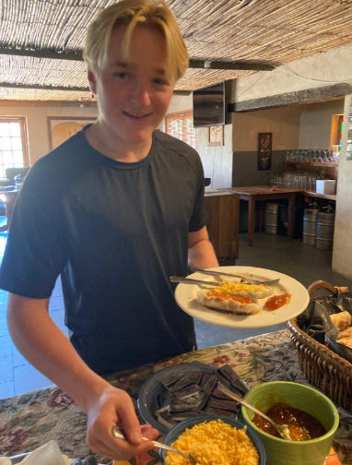
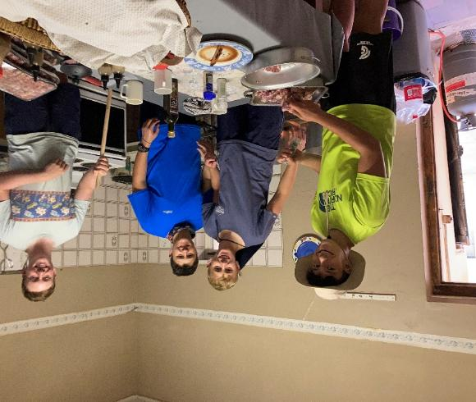
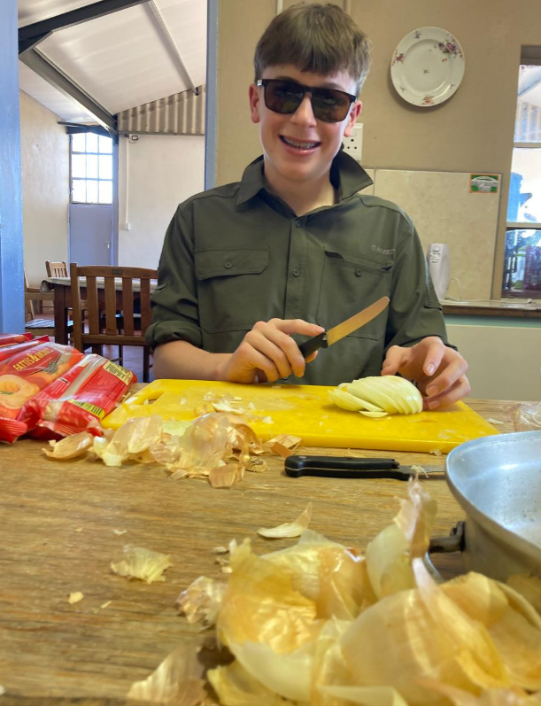
EPIC 2024 FOOD

Slide 2
We provide food for you at the bases.
Muslim, Vegetarian and others with specific requirements need to make contact with Mr Klerck if not done already. You are fully catered for.
All boys are responsible for their own food for the two hikes and for 24 hr solo.
Medical info – linked to food.

Slide 3

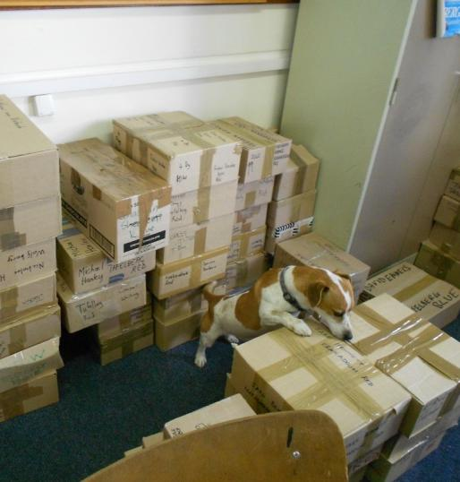
THREE CONTAINERS
Mr Klerck will tell you when you can go to Mr Court to fetch a small box (24 hr solo) and a larger box (second hike).
Pack the food for your first hike in your bag – even if you do not hike first.
Before your second hike, we issue you with your larger hiking food box.
We open boxes in your presence and reserve the right to search.

Slide 4
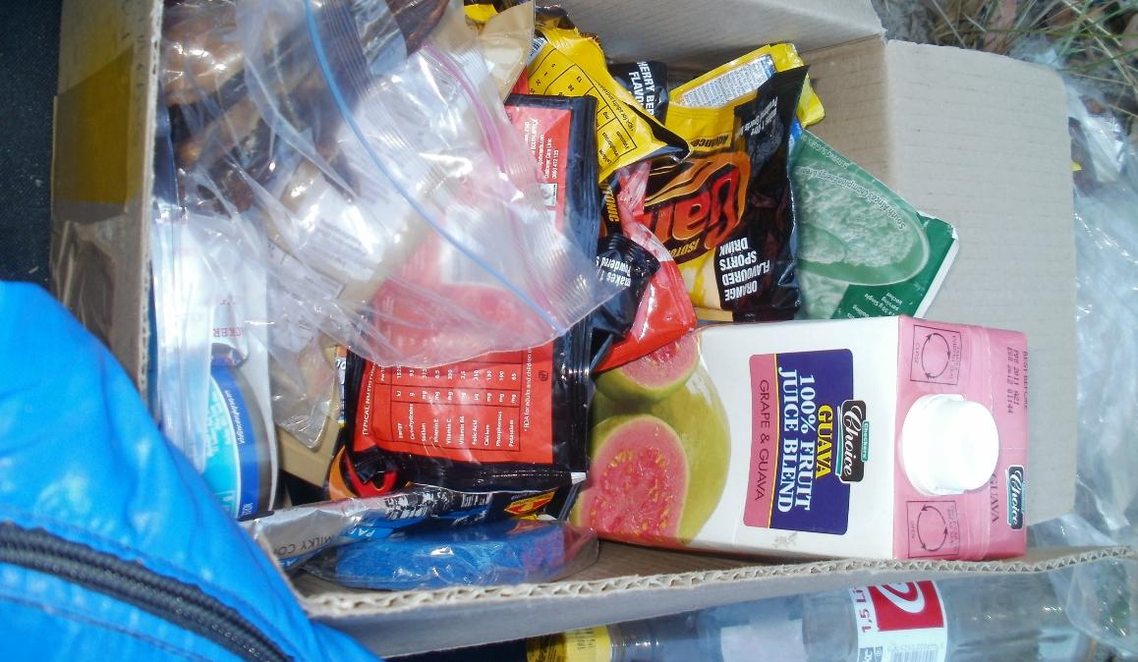
What to take?
List is online and you have copies
Less is best
Stove (shared). School supplies
Pot (put stuff in it) – buy one
Utensils
Plate, Mug

Slide 5
RDA – Recommended Daily Allowance
RDA is 65 g Protein which is 14 000 kJ
We recommend well over 100 g which is 20 000 kJ
We suggest:
2 x Tuna plus 2 x noodles – 3 700 kJ
Back Country Beef Curry (175 g pack; also comes in 90 g) – 2 970 kJ
Travellunch Beef Stroganoff – 1816 kJ
Depending on which pack is available you might need to eat 2 x Back Country!
1 pack Back Country costs R280 as against the R80 for tuna and noodles.

Slide 6
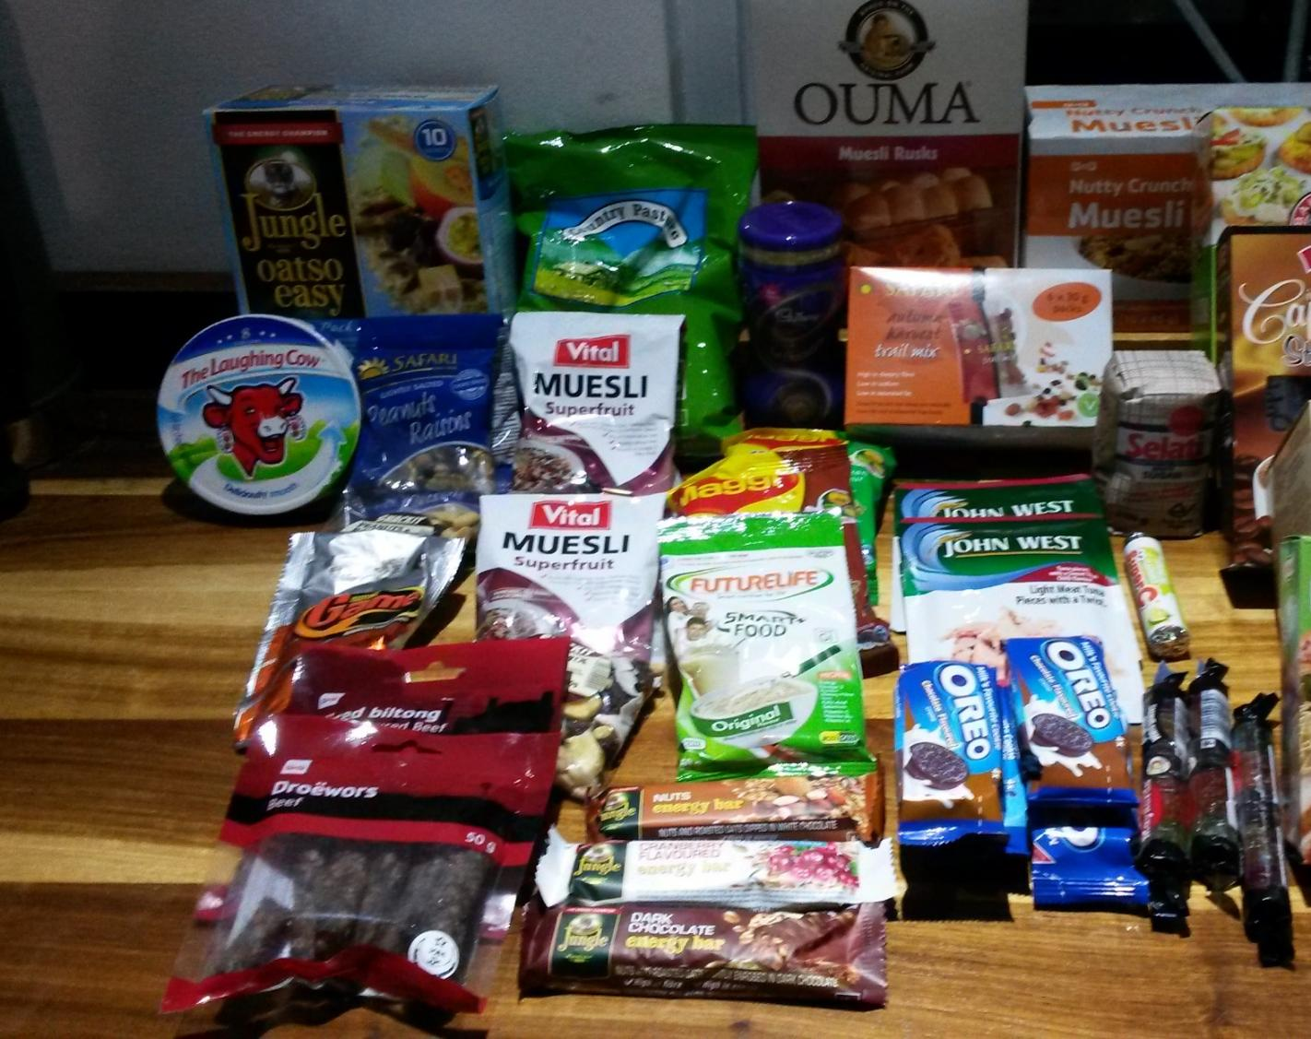
6 kilograms unsorted

Slide 7
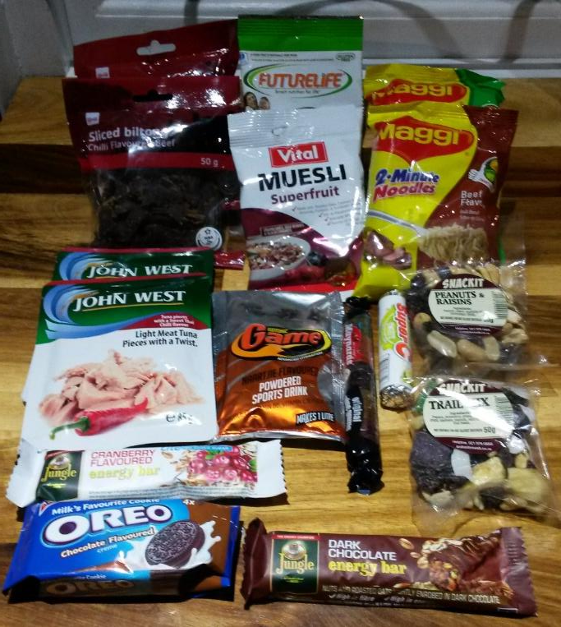
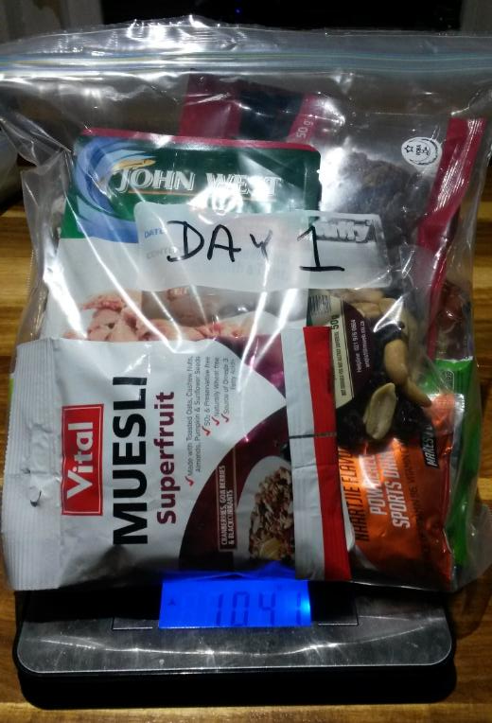
Food for one day – 1 kg

Slide 8
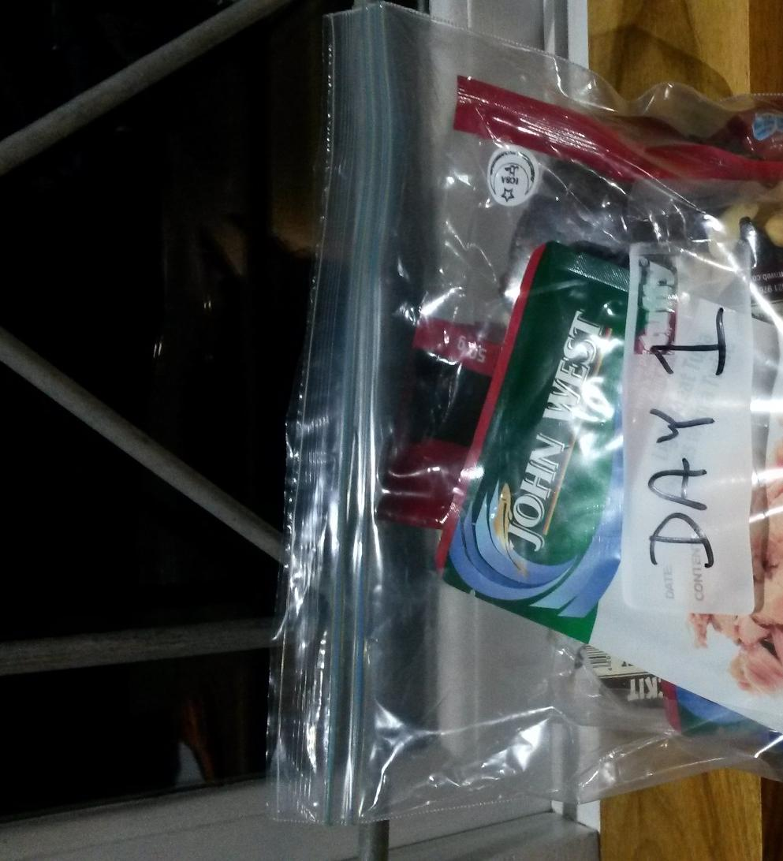
One day - One packet

Slide 9
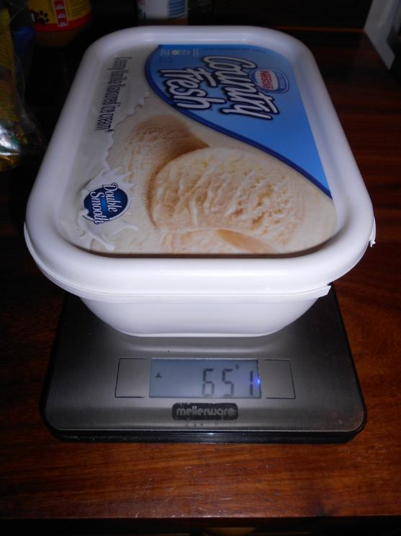
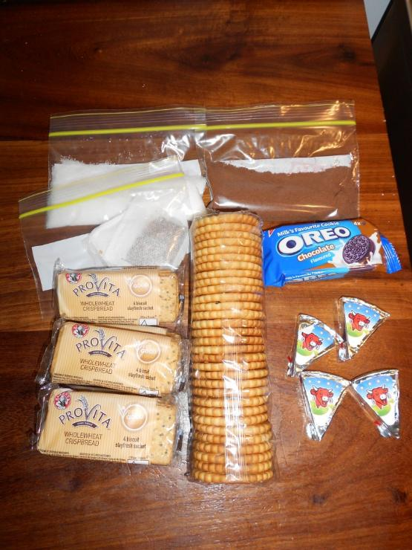
Cheese & Biscuits & hot drinks for 3 days – 651 grams

Slide 10
What to do?
Share milk powder?
Use your stove before you go – Handed out during prep week
Watch out for litter – use zip loc bags
Squash the rubbish into one bag
Wet matches; Use a lighter
Wind
Position
Fire safety
Burns
Washing up

Slide 11
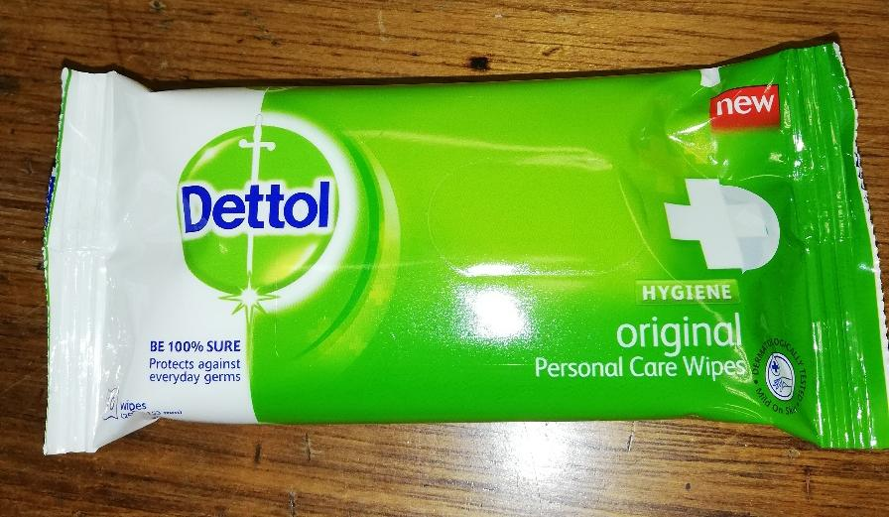
Hygiene
Don’t share your germs with others
Wash your utensils properly
Wash your hands
Drink sufficient water from your OWN water bottle

Slide 12
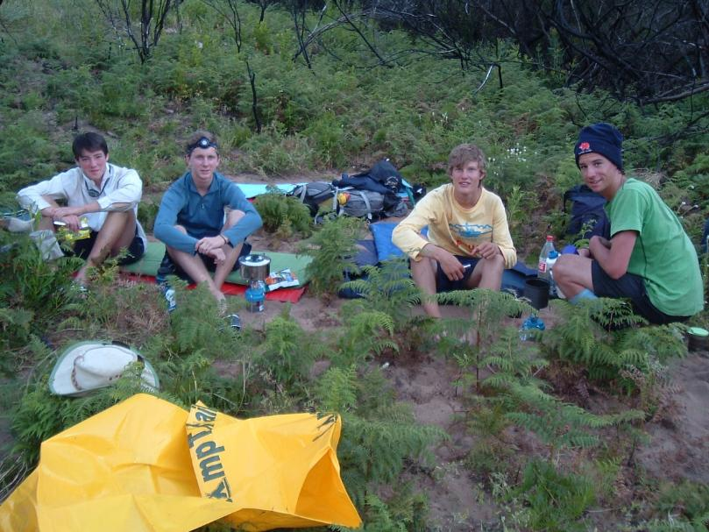
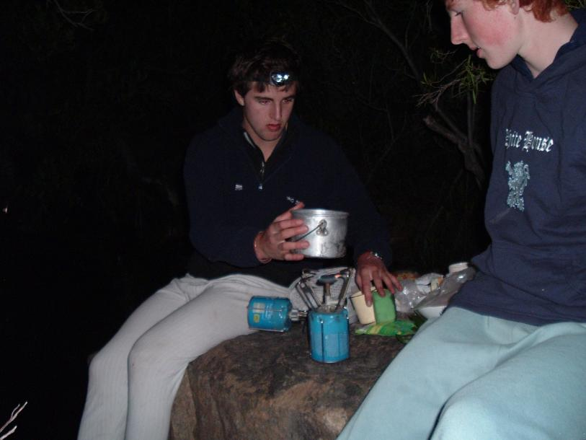
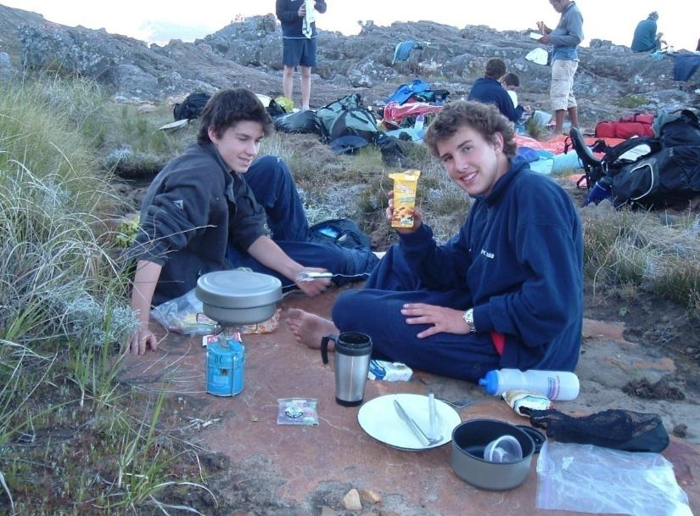
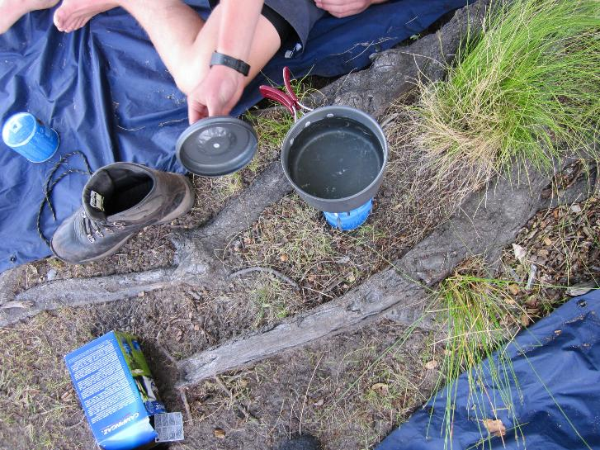

Slide 13
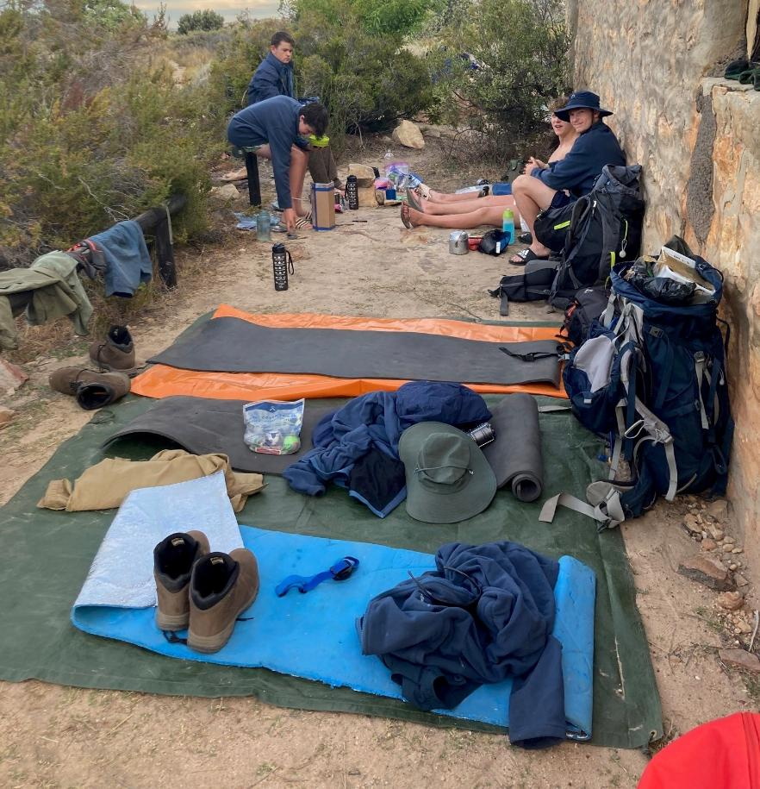
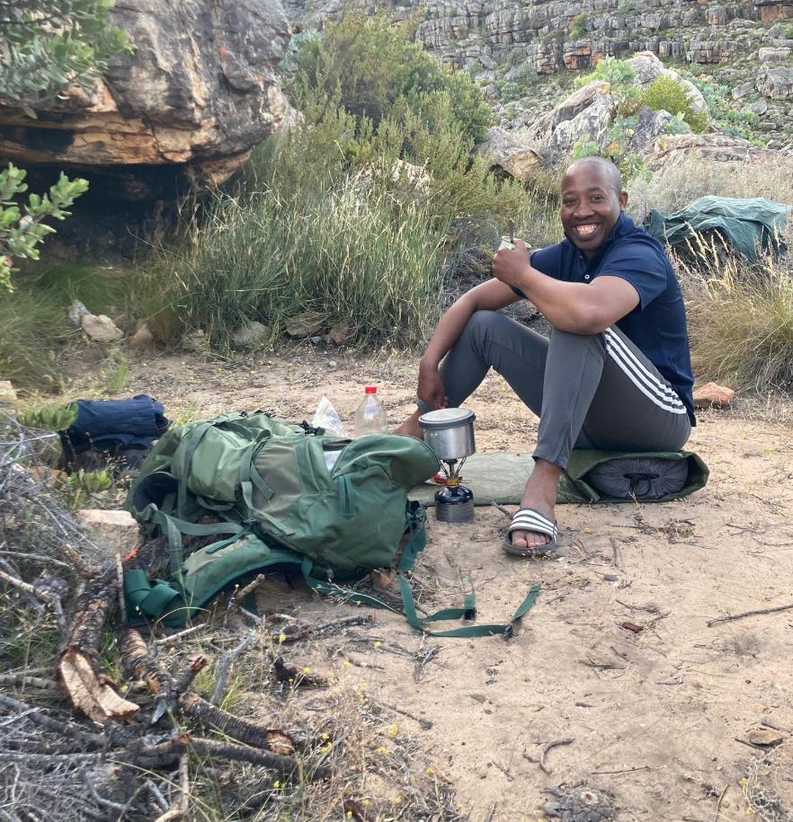

Slide 14
Packing
Get rid of excess packaging – reduce waste and weight
Pack only what you need
Use large zip locks and pack each day’s food in the zip lock. Label the outside.
Put your things such as tea, coffee etc in their own zip lock.
Sweet/energy bar supply
Try some of the food first

Slide 15
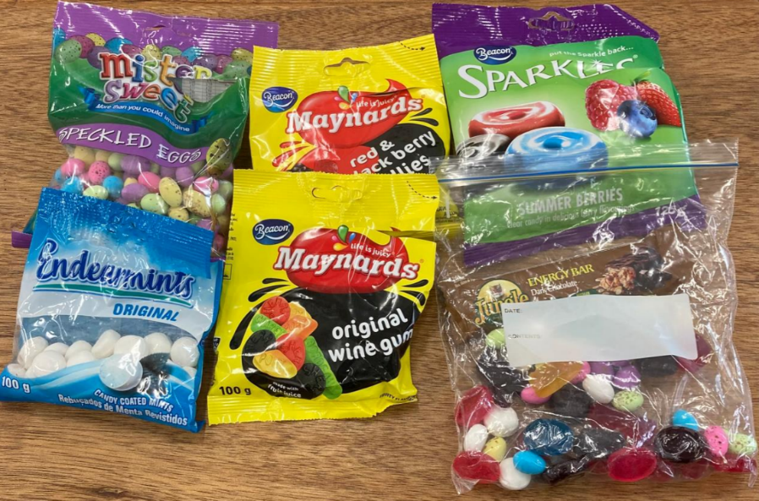
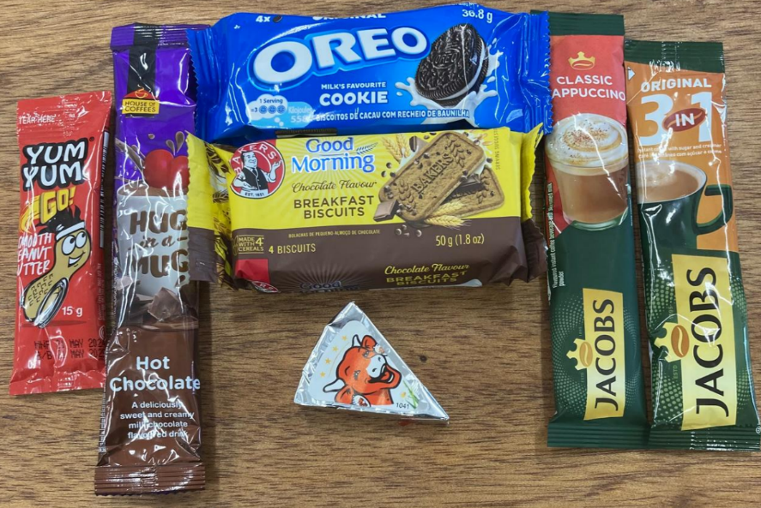
Packing

Slide 16
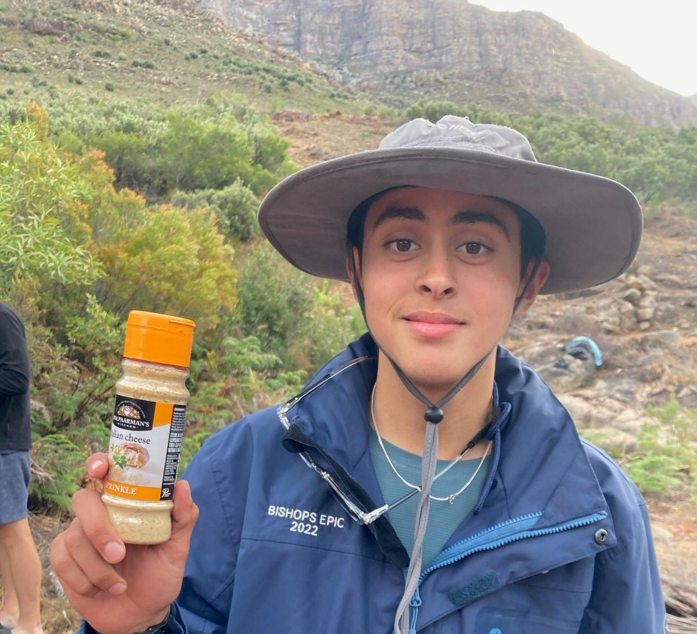

Slide 17
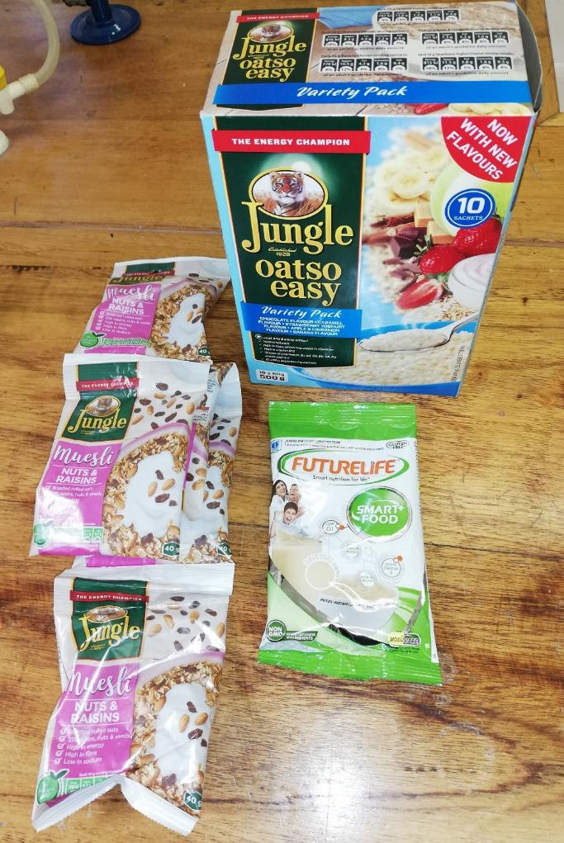
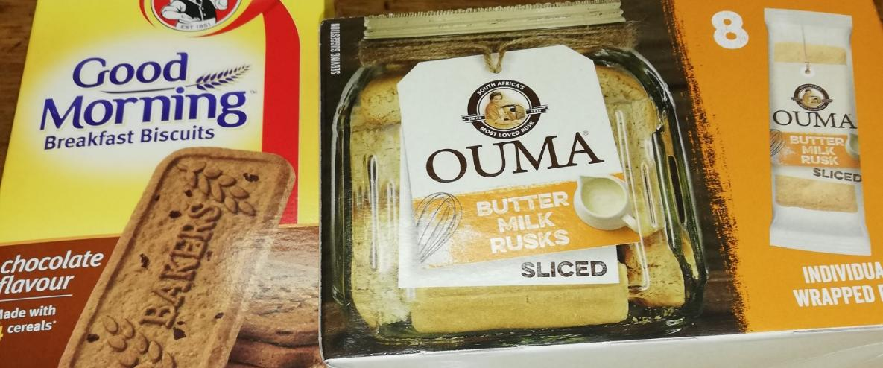
Breakfast

Slide 18
Breakfast
Wake up early – 5 am....
Energy bar to start – don’t eat breakfast immediately – maybe only at 8 am
Oatso Easy or muesli/pronutro/milk powder
Rusk/Good Morning Biscuits and tea/coffee
Drink water

Slide 19
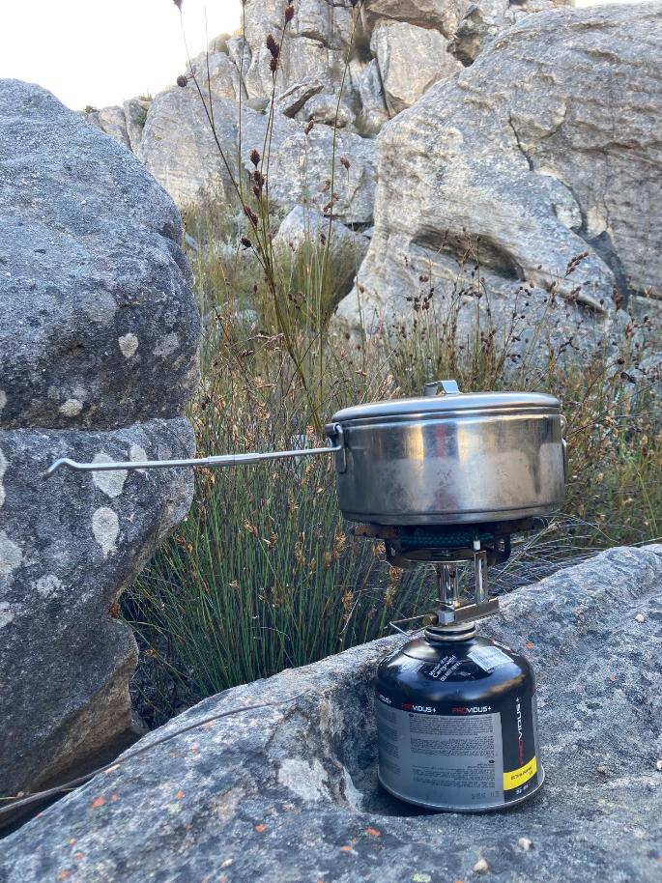


Slide 20
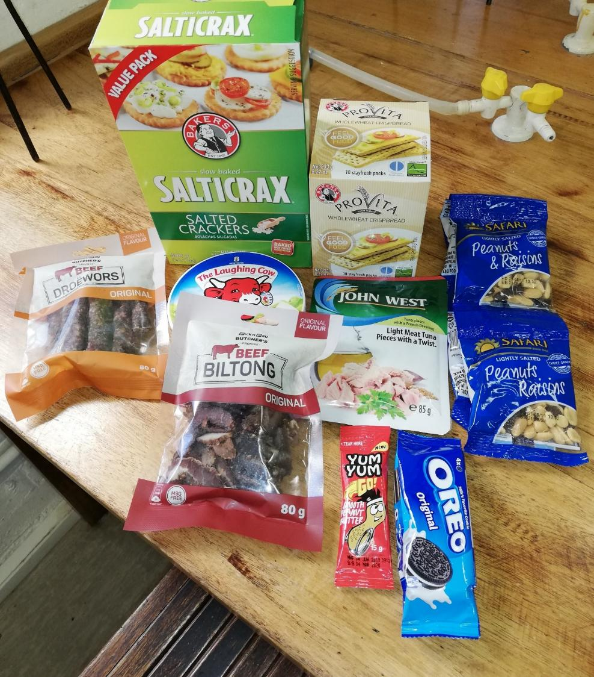
Lunch

Slide 21
Lunch
Crackers and tuna
Crackers and cheese
Dried fruit/Raisins
Biltong/Droë wors
Nuts
Usually don’t heat water at lunch
Drink water

Slide 22
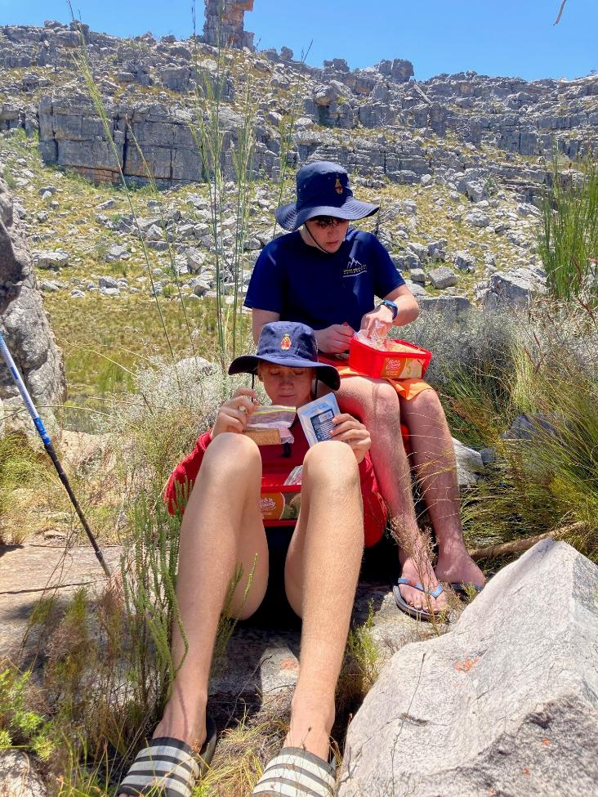

Slide 23
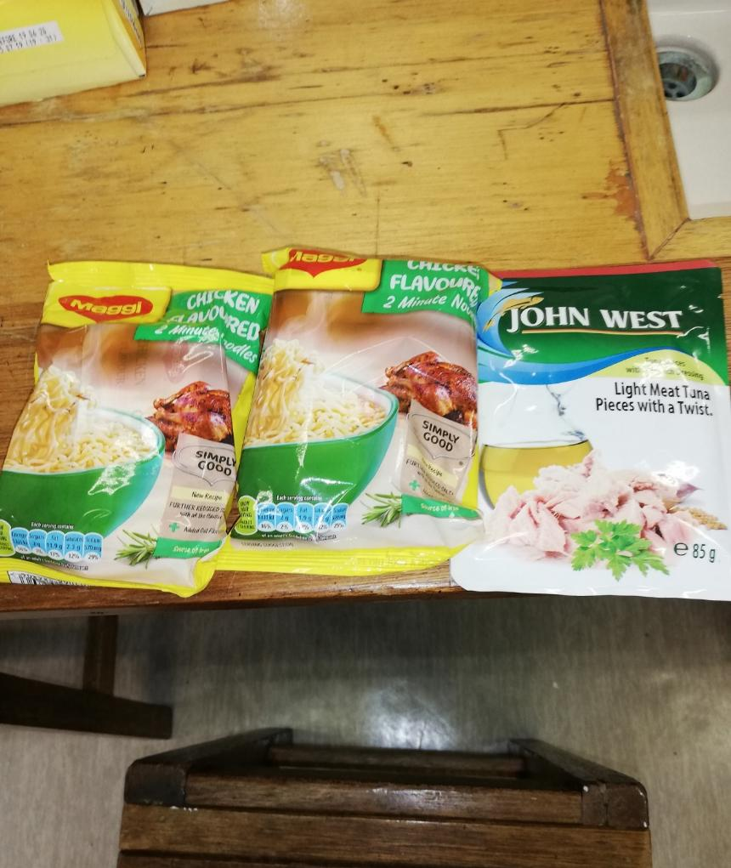
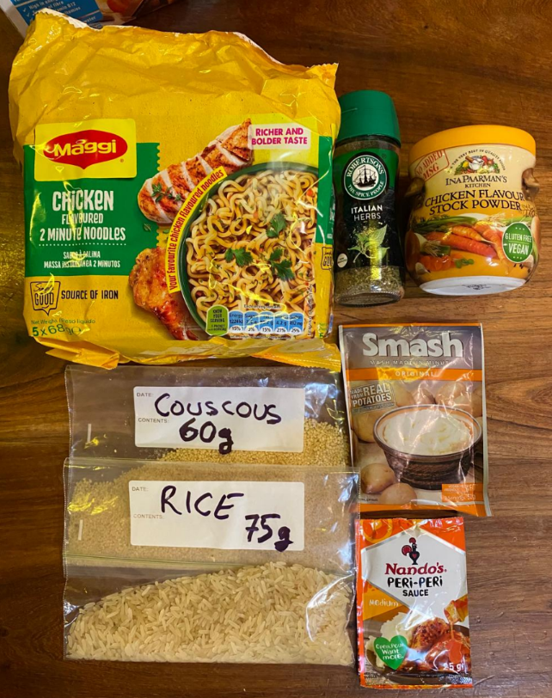
Supper

Slide 24
Supper
Drink water
You’re tired, you don’t want hassle
Two minute noodles
Tuna
Cup a Soup (if it is really cold)
Crackers
Droë wors/Biltong
Drink water

Slide 25
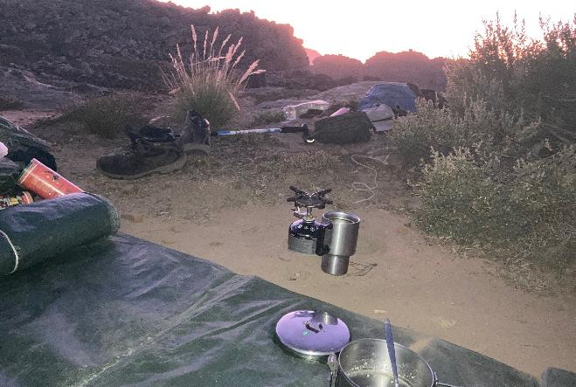
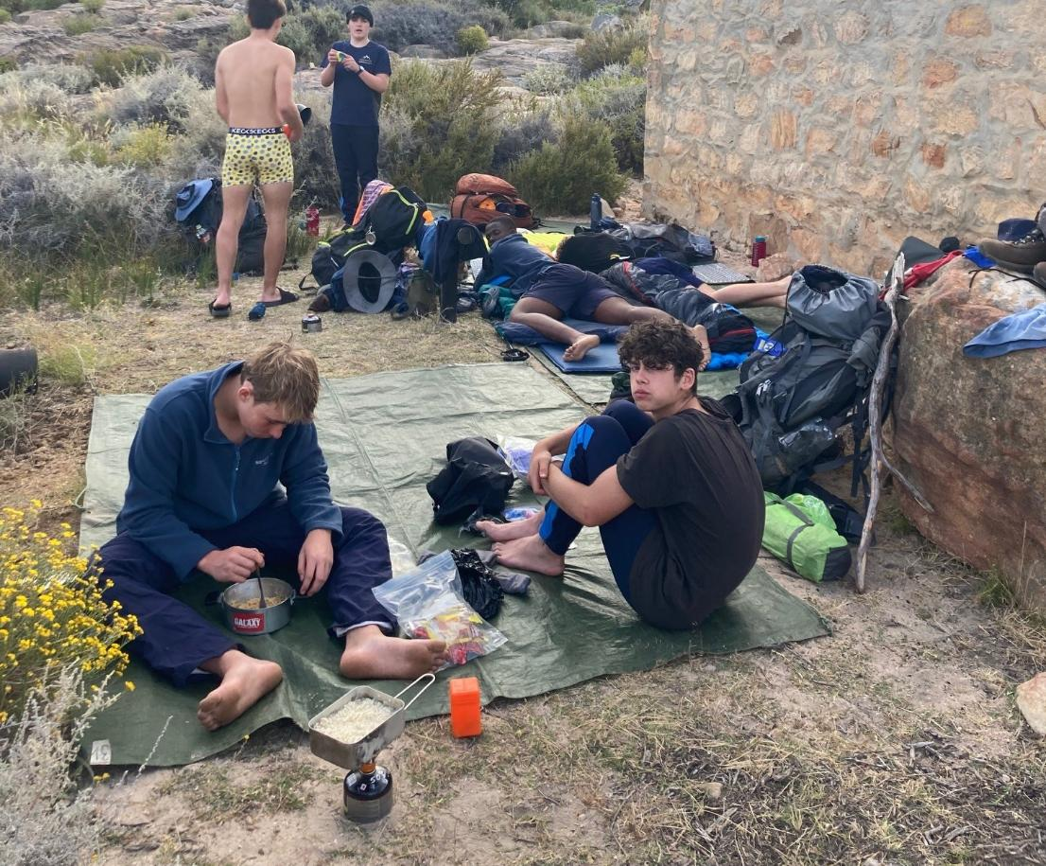
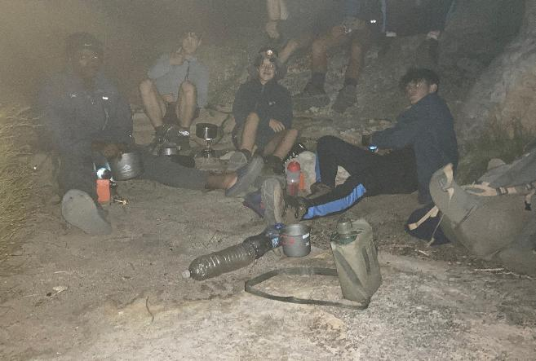

Slide 26
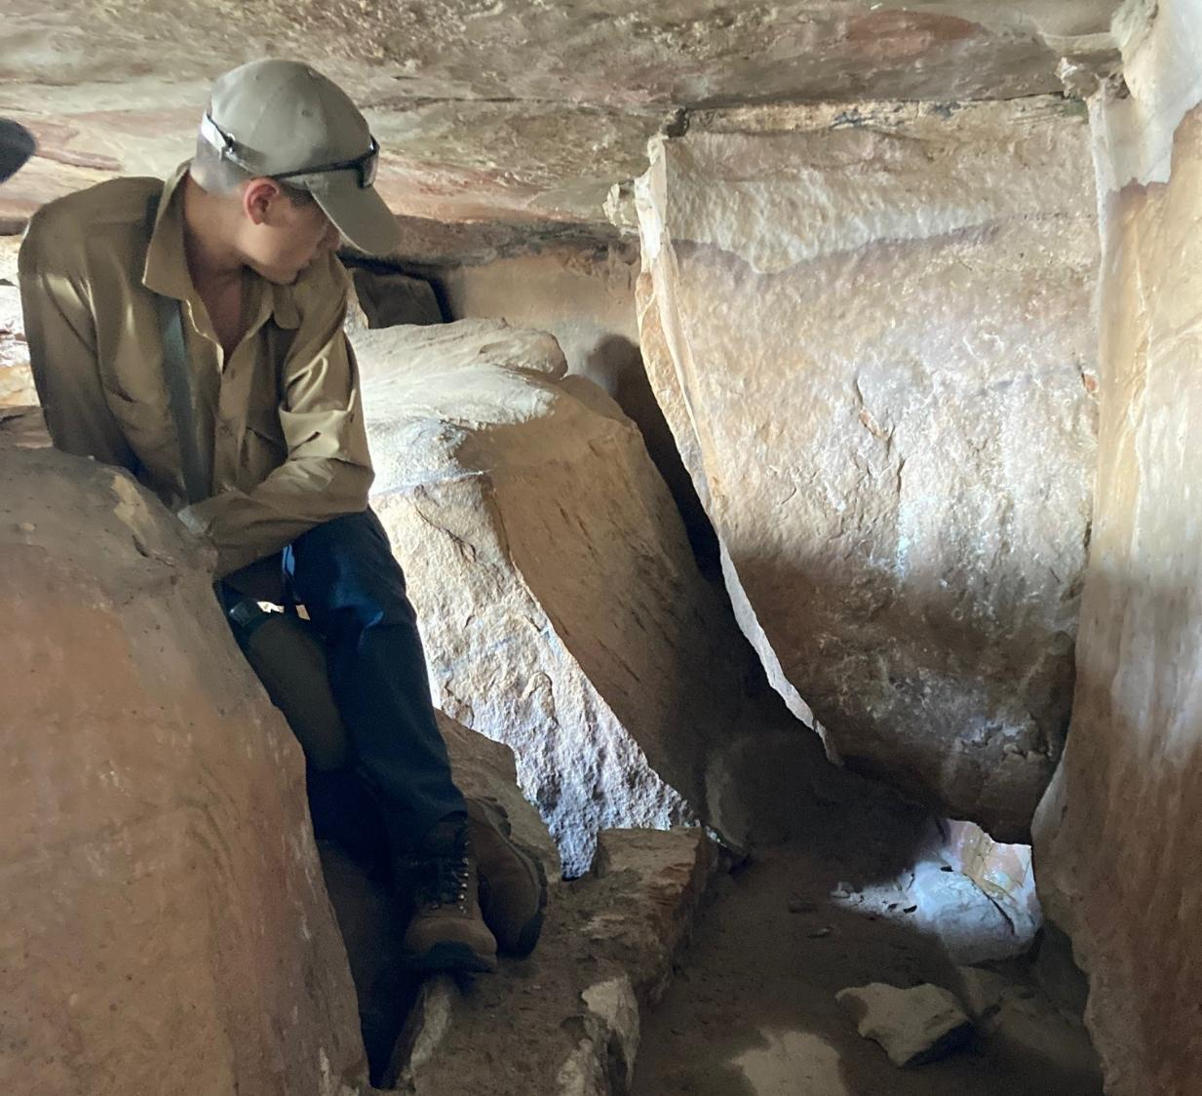

Slide 27
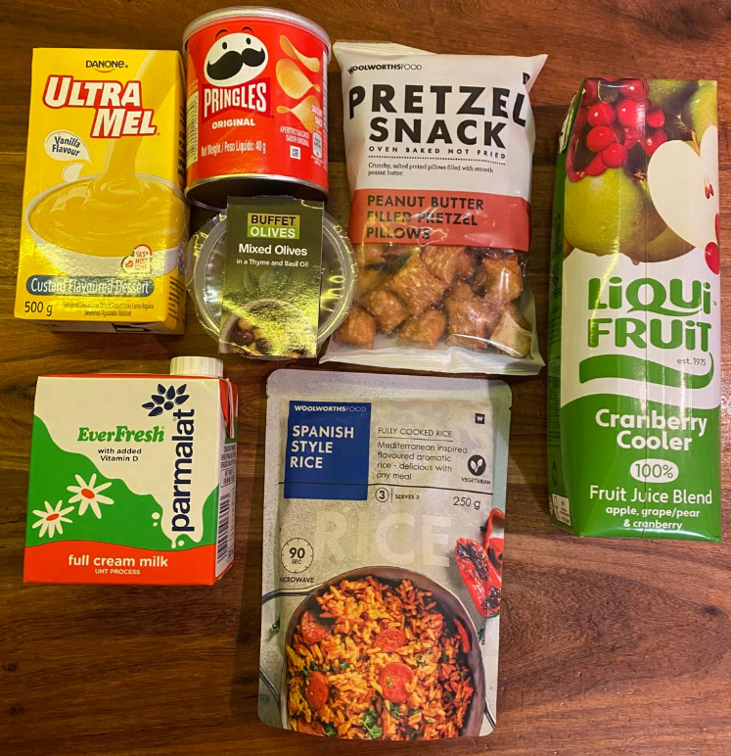
Solo

Slide 28
Solo
Juice
Nice food – weight not an issue
Some sweets
Don’t go overboard

Slide 29
WHAT NOW?
Fetch boxes from Mr Court when Mr Klerck tells you to
No spares available
Hand in between 11 and 15 Nov to Mr Court’s classroom
Fully labelled (on all sides) and completely sealed

